Slide 1
Presentation vers 2.1- 20 Mar 2023
Insert Name Here
Notes:
Welcome
Name and Hampshire Cyber Watch (around 20)
Police trained and vetted
This presentation has been created in conjunction with HINWA and Police crime Unit
40 mins, Q&A, and time at end

Slide 2
What is Cyber crime?
How does Cyber crime work?
How do we protect ourselves ?
How do you report Cyber crime ?
Where to get further information / support ?
Notes:
Before we start, a quick Survey: How many of you have a PC, Tablet, Smartphone, Phone Line?
What is Cyber – commonplace word for digital – so Cyber crime is basically digital wrongdoing
UK losses in 2020/2021 £2.35bn (Mainly biz.
Thankfully the advice is straightforward, and there is plenty of support
This presentation gives simple tips and guidance so that we can avoid being one of the stats

Slide 3
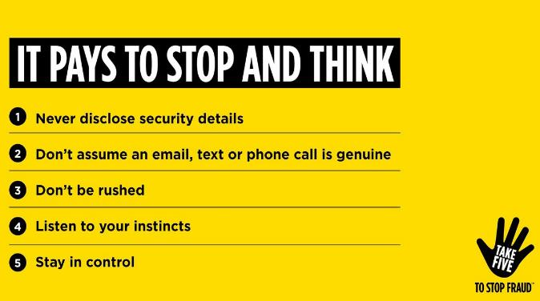
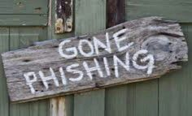
Presentation - January 2023
How does Cyber Crime work?
Spam Email
Social Media ads or messages
Text or Whats App messages
Unsolicited Phone calls
Take the test - https://www.takefive-stopfraud.org.uk
Notes:
The most common way for individuals to be caught up in Cybercrime is by responding to a fraudulent message and giving away credentials or even cash!
This technique is known as “Phishing” and the bad guys pretend to be from your bank, a shop, a credit card company, computer support or even the FBI to try and lure you into revealing personal data.
Stop and think – Take 5!

Slide 4
How can we protect ourselves?
Be “Cyber Aware” – search “cyber aware” or visit https://www.ncsc.gov.uk/cyberaware/home
Here you can find out:
How to secure your e-mail How to use two-step verification (2SV)
How to store passwords securely
How to backup your data How to keep your devices updated
Notes:
The National Cyber Security Centre is a branch of GCHQ and is responsible for the digital security of the nation.
Visit https://www.ncsc.gov.uk/cyberaware/home or search “cyber aware” for top tips on staying safe online.
All the information that follows is based upon their advice and will help you protect your digital assets.

Slide 5
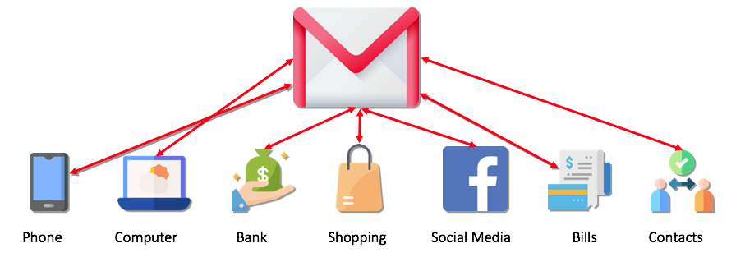
How can we protect ourselves?
Your email is where you keep your most personal and financial information.
If a cyber criminal accesses your email, they could:
access your other online accounts using the 'forgot password' feature (which often sends you an email)
access personal or business information and use this to scam you or people you know
Notes:
For most people, access to their e-mail account is having the keys to their digital castle.

Slide 6
How can we protect ourselves?
Secure your e-mail with a strong passphrase – three random words
Complex passwords are hard for people to remember and no more difficult to crack than letters on their own.
Choosing three random words and stringing them together into a phrase is easier to remember than a password with number substitution and the length makes it harder for computers to crack.
A password of 12 or more characters is recommended by NCSC.
Three random words – ‘applenemopen’ or ‘fruitflounderbiro’
Notes:
For most people, access to their e-mail account is having the keys to their digital castle.
Using a long passphrase rather than a complex password is recommended by NCSC.
Should you want further information, there is a link from the Cyber Aware pages that explains the logic behind the three random words idea - https://www.ncsc.gov.uk/blog-post/the-logic-behind-three-random-words

Slide 7
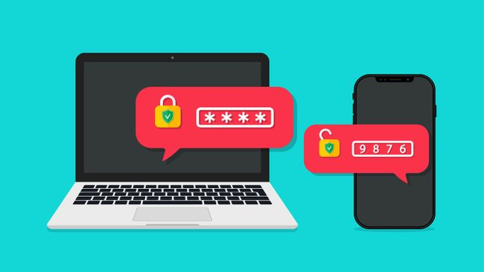
How can we protect ourselves?
Turn on Two-step verification (2SV)
2-step verification involves using a second device to verify your identity.
This could be a mobile phone app, a chip and pin device, a fingerprint reader or even a telephone.
Most banks use an authentication device to enable online banking. This works in the same way as a 2SV app on your phone.
Using 2SV will normally stop a criminal accessing your data, even with your password!
Notes:
2SV, also know as 2FA (two factor authentication) or MFA (multi-factor authentication) is an extra layer of security on your digital accounts.
It is like a burglar getting into your house and then finding that all of your valuables as locked in a safe.

Slide 8
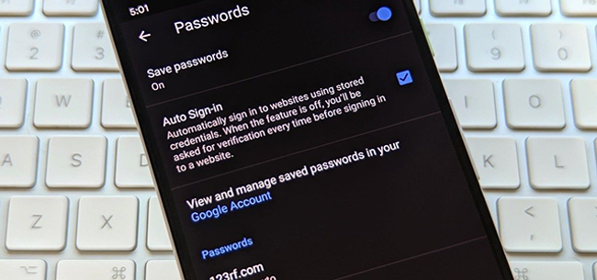
How can we protect ourselves?
Use a Password Manager or Browser Password store
We all have lots of passwords these days and the temptation is to use the one password that you can remember for all accounts.
Password managers will securely suggest and store long passwords for you, often across multiple devices, and you only have to remember the one passphrase (made of three random words, of course!)
Take care on shared computers!
Use a strong memorable password to secure your password manager
Notes:
You wouldn’t use the same key for every lock, so why would you use the same password for every account?
If you share a computer with other people, make sure that they all have their own password to access the computer and cannot access each others password manager.

Slide 9
How can we protect ourselves?
Backup your device’s data regularly
Backing up your data will ensure that you are able to recover critical information in the event of your computer becoming corrupted or getting stolen.
You can back up to a USB stick, an external hard disk or a cloud account.
Most computers, tablets or phones have software built in to take backups.
Back up any data that would inconvenience you if it were lost
Notes:
Make use of the supplied backup utilities with your device or use one of the many commercial backup applications available.

Slide 10
How can we protect ourselves?
Keep your devices up to date
Computer manufacturers regularly release operating system and security updates, as do the providers of anti-virus software.
These should be downloaded and applied as soon as they are available to stay as secure a possible.
If you get an update notification, install the updates as soon as you can
Notes:
Security updates are often released to counter the latest threats that are affecting peoples computers, so it is critical to keep as up to date as you can.

Slide 11
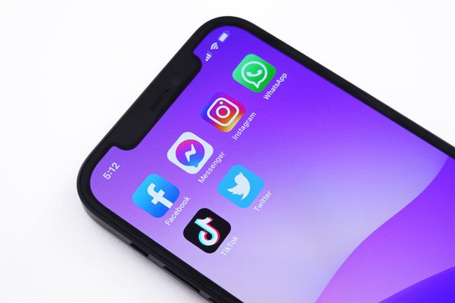
How can we protect ourselves?
Check your Privacy settings
All social media platforms have privacy settings to help you keep your personal information private.
Advice on protecting your accounts can be found on the NCSC advice and guidance page.
Don’t over share - Keep your personal information private!
Notes:
Security updates are often released to counter the latest threats that are affecting peoples computers, so it is critical to keep as up to date as you can.

Slide 12
Notes:
Demonstrating how our personal data can be used to convince us their scams are genuine.

Slide 13
BLANK SLIDE FOR OPTIONAL VIDEO INSERTION
(Delete if not required)
Notes:
BLANK SLIDE FOR OPTIONAL VIDEO INSERTION

Slide 14
How can we report Cyber crime?
If you think you have been the victim of a Cyber crime or fraud, it can be easily reported by visiting the Action Fraud website.
You report a Cyber crime or fraud offence by telephone to Action Fraud using 0300 123 2040.
If you have suffered financial loss, you should also contact your bank or credit card provider.
Phishing attempts can be simply forwarded to report@phishing.gov.uk or if they are text messages, by forwarding them to 7726.
Reporting Cyber crime helps investigators and protects future victims
Notes:
Action Fraud is an organisation set up by the Home Office to take reports of fraud and cyber crime. They work with police Cyber crime teams, financial industry bodies and tech companies to combat cyber attacks and raise awareness.
Investigations can take a long time to produce a result and may involve investigators from multiple countries and jurisdictions. Despite this it is still important to report any incidents and you can help to protect others.
If you are ever in immediate danger, always call 999.

Slide 15
A Quick recap:
Secure your e-mail accounts Use 2-step verification Backup your devices
Use a password manager Keep devices updated Use privacy settings
Need further help?
Search “cyber aware” to get up to date information.
Contact Hampshire CyberWatch and use the red “Request Help” button to arrange for a Cyber Champion to get in touch.
Thank you for listening! Any Questions?
Notes:
Action Fraud is an organisation set up by the Home Office to take reports of fraud and cyber crime. They work with police Cyber crime teams, financial industry bodies and tech companies to combat cyber attacks and raise awareness.
Investigations can take a long time to produce a result and may involve investigators from multiple countries and jurisdictions. Despite this it is still important to report any incidents and you can help to protect others.
If you are ever in immediate danger, always call 999.
If you are unsure or need further advice, contact Hampshire CyberWatch via their website and use the red button to call for help!

